Slide 1
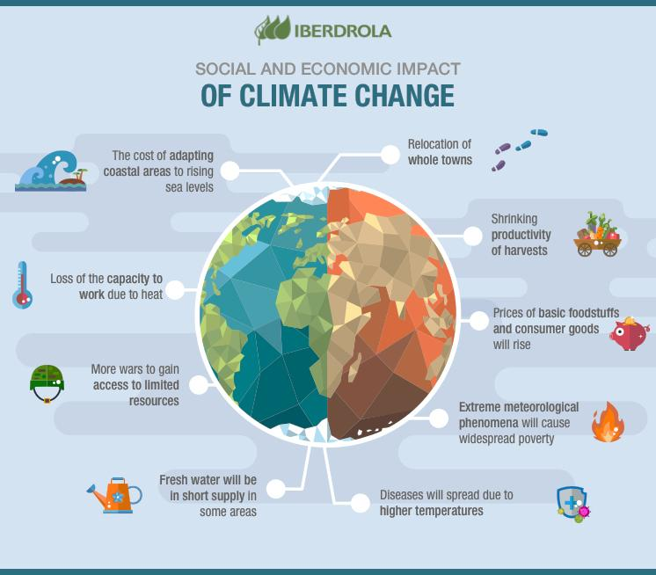
CLIMATE CHANGE IN PAKISTAN

Slide 2
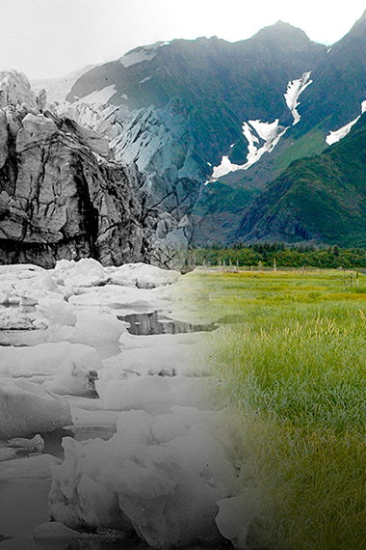
What is Climate Change?
According to the BBC Climate Asia report,
53% of Pakistanis felt that their lives had become worse off than they were five years ago.
ascribed changes in climate and extreme weather events to the will of God."
According to the Pakistan Economic Survey of 2014-15,
"increase in frequency and intensity of extreme weather events coupled with erratic monsoon rains causing frequent and intense floods and droughts"
By: KABEER AHMED

Slide 3
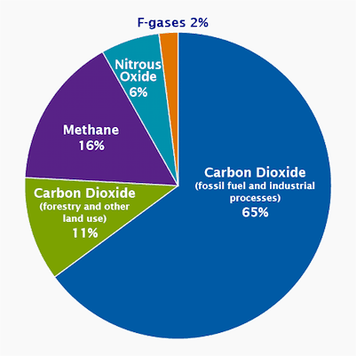
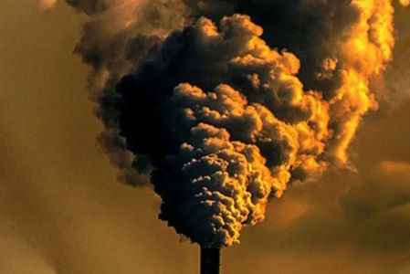
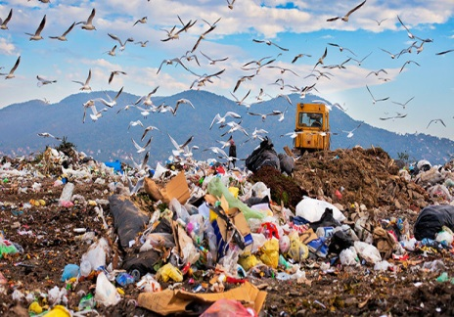
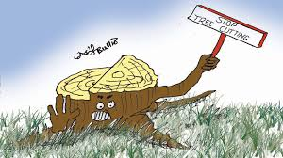
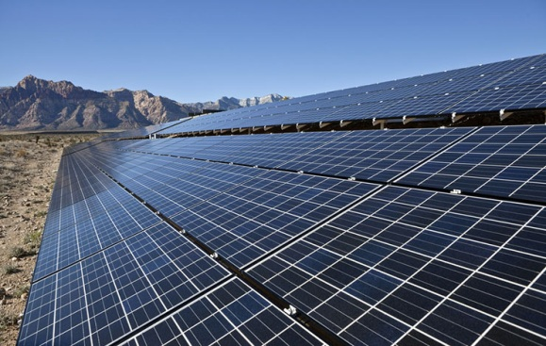
Causes Of Climate Change
Greenhouse Gas
Air Pollution
Waste
Deforestation
Technology
By: KABEER AHMED

Slide 4
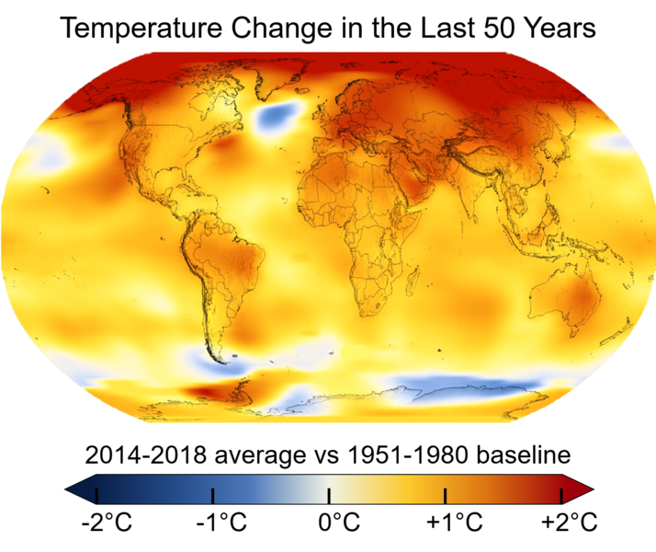

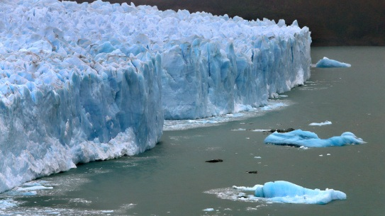
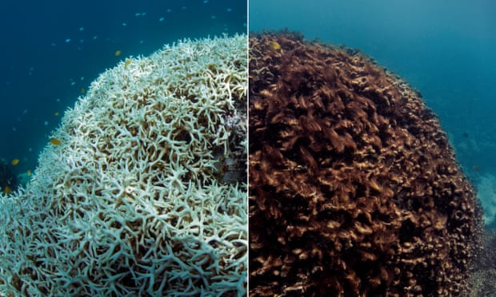
Effects Of Climate Change
Rise in Temperature
Health Effects
Glacier Melt and Floods
Impacts on Aquatic Life
By: KABEER AHMED

Slide 5



Solutions Of Climate Change
Avoid Transportation
Avoid Technology
Stop Cutting Down Trees
Creating Knowledge
Waste Management
By: KABEER AHMED

Slide 6
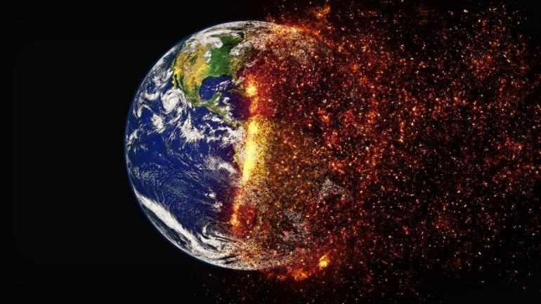
Conclusion
Historical Value(2047)
United Nations’ IPCC(2036)
U.S. National Academy of Sciences
“Humans are changing Earth’s climate, primarily through greenhouse gas emissions."
By: KABEER AHMED

Slide 7
Thank you
By: KABEER AHMED

